Slide 1
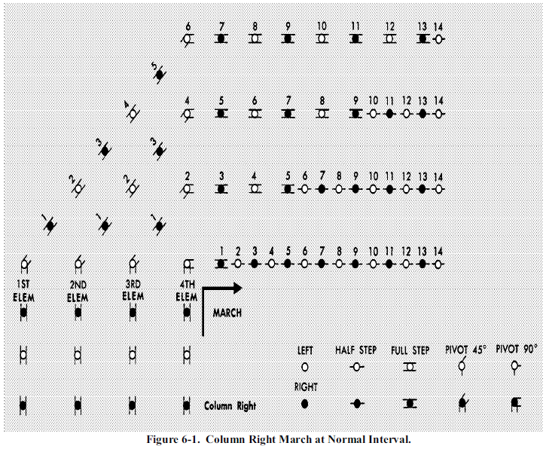
Drill of the Flight
14 13 12 11 10 9 8 7 6
5
14 13 12 11 10 9 8 7 6 5 4
4
3
3
14 13 12 11 10 9 8 7 6 5 4 3 2
2
2
1
1
1
14 13 12 11 10 9 8 7 6 5 4 3 2 1
1ST 2nd 3rd 4th
Elem Elem Elem Elem
MARCH
RIGHT
LEFT
Column Left
COLUMN LEFT

Slide 2
COLUMN LEFT
LEFT
HALF STEP
FULL STEP
PIVOT 45⁰
PIVOT 90⁰
RIGHT

Slide 3
COLUMN LEFT
LEFT
HALF STEP
FULL STEP
PIVOT 45⁰
PIVOT 90⁰
RIGHT

Slide 4
COLUMN LEFT
LEFT
HALF STEP
FULL STEP
PIVOT 45⁰
PIVOT 90⁰
Column Left
RIGHT

Slide 5
COLUMN LEFT
Nothing on Right
LEFT
HALF STEP
FULL STEP
PIVOT 45⁰
PIVOT 90⁰
RIGHT

Slide 6
COLUMN LEFT
March
LEFT
HALF STEP
FULL STEP
PIVOT 45⁰
PIVOT 90⁰
RIGHT

Slide 7
COLUMN LEFT
LEFT
HALF STEP
FULL STEP
PIVOT 45⁰
PIVOT 90⁰
RIGHT

Slide 8
COLUMN LEFT
LEFT
HALF STEP
FULL STEP
PIVOT 45⁰
PIVOT 90⁰
RIGHT

Slide 9
COLUMN LEFT
LEFT
HALF STEP
FULL STEP
PIVOT 45⁰
PIVOT 90⁰
RIGHT

Slide 10
COLUMN LEFT
LEFT
HALF STEP
FULL STEP
PIVOT 45⁰
PIVOT 90⁰
RIGHT

Slide 11
COLUMN LEFT
LEFT
HALF STEP
FULL STEP
PIVOT 45⁰
PIVOT 90⁰
RIGHT

Slide 12
COLUMN LEFT
LEFT
HALF STEP
FULL STEP
PIVOT 45⁰
PIVOT 90⁰
RIGHT

Slide 13
COLUMN LEFT
LEFT
HALF STEP
FULL STEP
PIVOT 45⁰
PIVOT 90⁰
RIGHT

Slide 14
COLUMN LEFT
LEFT
HALF STEP
FULL STEP
PIVOT 45⁰
PIVOT 90⁰
RIGHT

Slide 15
COLUMN LEFT
LEFT
HALF STEP
FULL STEP
PIVOT 45⁰
PIVOT 90⁰
RIGHT

Slide 16
COLUMN LEFT
LEFT
HALF STEP
FULL STEP
PIVOT 45⁰
PIVOT 90⁰
RIGHT

Slide 17
COLUMN LEFT
LEFT
HALF STEP
FULL STEP
PIVOT 45⁰
PIVOT 90⁰
RIGHT

Slide 18
COLUMN LEFT
LEFT
HALF STEP
FULL STEP
PIVOT 45⁰
PIVOT 90⁰
RIGHT

Slide 19
COLUMN LEFT
LEFT
HALF STEP
FULL STEP
PIVOT 45⁰
PIVOT 90⁰
RIGHT

Slide 20
COLUMN LEFT
LEFT
HALF STEP
FULL STEP
PIVOT 45⁰
PIVOT 90⁰
RIGHT

Slide 21
COLUMN LEFT
LEFT
HALF STEP
FULL STEP
PIVOT 45⁰
PIVOT 90⁰
RIGHT

Slide 22
COLUMN LEFT
LEFT
HALF STEP
FULL STEP
PIVOT 45⁰
PIVOT 90⁰
RIGHT

