Slide 1
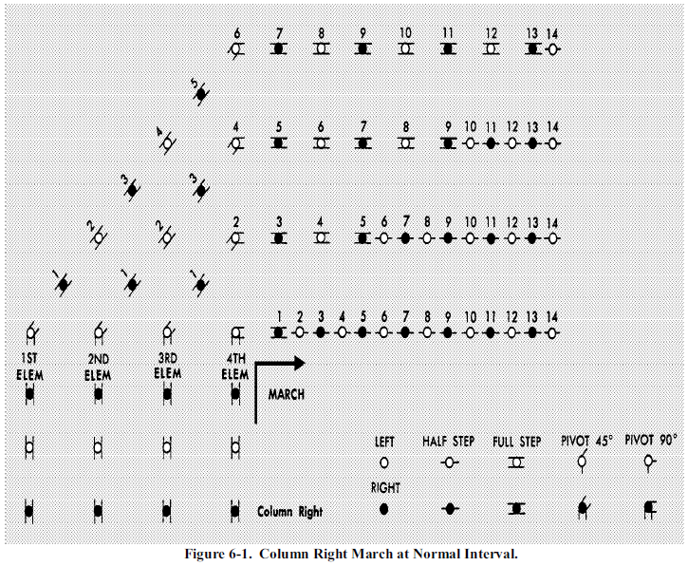
Drill of the Flight
COLUMN RIGHT

Slide 2
COLUMN RIGHT
LEFT
HALF STEP
FULL STEP
PIVOT 45⁰
PIVOT 90⁰
RIGHT

Slide 3
COLUMN RIGHT
LEFT
HALF STEP
FULL STEP
PIVOT 45⁰
PIVOT 90⁰
RIGHT

Slide 4
COLUMN RIGHT
LEFT
HALF STEP
FULL STEP
PIVOT 45⁰
PIVOT 90⁰
Column Right
RIGHT

Slide 5
COLUMN RIGHT
Nothing on the Left
LEFT
HALF STEP
FULL STEP
PIVOT 45⁰
PIVOT 90⁰
RIGHT

Slide 6
COLUMN RIGHT
March
LEFT
HALF STEP
FULL STEP
PIVOT 45⁰
PIVOT 90⁰
RIGHT

Slide 7
COLUMN RIGHT
LEFT
HALF STEP
FULL STEP
PIVOT 45⁰
PIVOT 90⁰
RIGHT

Slide 8
COLUMN RIGHT
LEFT
HALF STEP
FULL STEP
PIVOT 45⁰
PIVOT 90⁰
RIGHT

Slide 9
COLUMN RIGHT
LEFT
HALF STEP
FULL STEP
PIVOT 45⁰
PIVOT 90⁰
RIGHT

Slide 10
COLUMN RIGHT
LEFT
HALF STEP
FULL STEP
PIVOT 45⁰
PIVOT 90⁰
RIGHT

Slide 11
COLUMN RIGHT
LEFT
HALF STEP
FULL STEP
PIVOT 45⁰
PIVOT 90⁰
RIGHT

Slide 12
COLUMN RIGHT
LEFT
HALF STEP
FULL STEP
PIVOT 45⁰
PIVOT 90⁰
RIGHT

Slide 13
COLUMN RIGHT
LEFT
HALF STEP
FULL STEP
PIVOT 45⁰
PIVOT 90⁰
RIGHT

Slide 14
COLUMN RIGHT
LEFT
HALF STEP
FULL STEP
PIVOT 45⁰
PIVOT 90⁰
RIGHT

Slide 15
COLUMN RIGHT
LEFT
HALF STEP
FULL STEP
PIVOT 45⁰
PIVOT 90⁰
RIGHT

Slide 16
COLUMN RIGHT
LEFT
HALF STEP
FULL STEP
PIVOT 45⁰
PIVOT 90⁰
RIGHT

Slide 17
COLUMN RIGHT
LEFT
HALF STEP
FULL STEP
PIVOT 45⁰
PIVOT 90⁰
RIGHT

Slide 18
COLUMN RIGHT
LEFT
HALF STEP
FULL STEP
PIVOT 45⁰
PIVOT 90⁰
RIGHT

Slide 19
COLUMN RIGHT
LEFT
HALF STEP
FULL STEP
PIVOT 45⁰
PIVOT 90⁰
RIGHT

Slide 20
COLUMN RIGHT
LEFT
HALF STEP
FULL STEP
PIVOT 45⁰
PIVOT 90⁰
RIGHT

Slide 21
COLUMN RIGHT
LEFT
HALF STEP
FULL STEP
PIVOT 45⁰
PIVOT 90⁰
RIGHT

Slide 22
COLUMN RIGHT
LEFT
HALF STEP
FULL STEP
PIVOT 45⁰
PIVOT 90⁰
RIGHT

