Slide 1
AISD Energy Management Program
Board of Trustees policy – Approved October 10, 2011

Slide 2
Program Goals
Comfortable Climate For Students And Teachers
Conserve Our Natural Resources
Save Money On Utility Costs
Notes:
Talk about bell curve 10%, 80%, 10%
Utility costs keep increasing

Slide 3
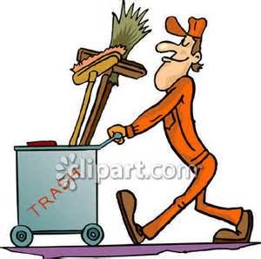
Cumulative Savings
$5,465,708
26.0% Cost Avoidance

Slide 4
The cheapest unit of energy is the one that is never used
Thank You For Helping! Our Energy Program Has Saved Over $4 MILLION! Every dollar saved on energy is a dollar saved for education.
If it Glows…..It Goes!
Here’s How You Can Do Your Part:
Adhere to conservation guidelines (Cooling/Heating within District Limits)
CLOSE CLASSROOM DOORS
Report malfunctioning equipment (Faucets, Toilets, Air Conditioners, Lights)
Turn off UNNECESSARY LIGHTING (Empty classrooms, naturally lit areas)
Turn PROJECTORS OFF when not in use (Between classes, lunch, etc.)
Use TLC in your area – control Thermostats, Lights and Computers
Energy Specialists - (Mike Scott - 8536) (Todd Whisenhunt – 7201)
Notes:
Cooling Limits are 72-78
Heating Limits are 68-72
Adjust your Tstats in your rooms within these limits
Computer Labs…Later start up, have students turn on and off

Slide 5
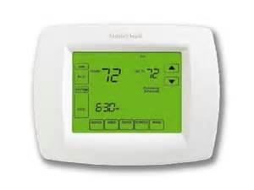
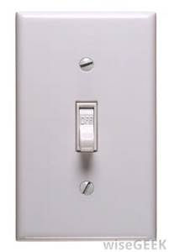
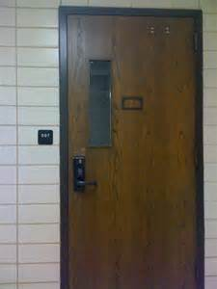
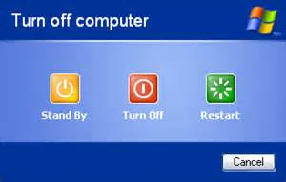
Energy Management Guide Daily Checklist
If It’s Not In Use, Turn off the Juice!
Thermostat settings 72-78 during cooling season, and 68-72 during heating season.
Turn off UNNECESSARY lighting (restroom/lunch/recess)
Close doors/blinds
Turn off ALL electronic devices
Notes:
Talk about Energy Audits…

Slide 6
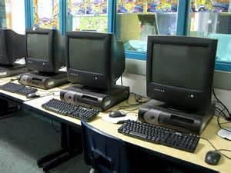
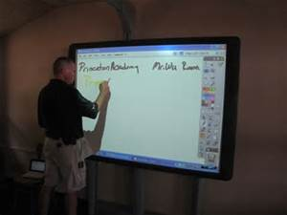
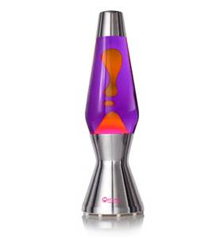
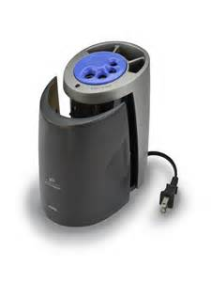
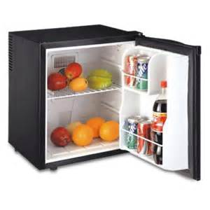
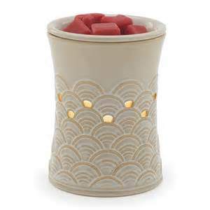
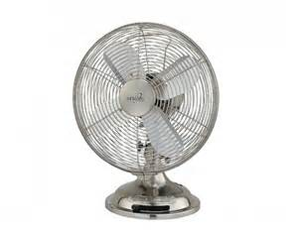
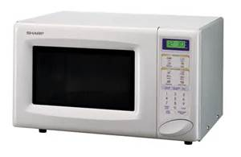
Shutdowns Unplug all electronic devices
Thanksgiving
Christmas
Spring Break
Summer
Notes:
Close Blinds
Checklists will be sent out the week of the shutdown…fill these out as you unplug and place in your box when you leave for the holiday
Drawings for prizes

Slide 7
SCHEDULING HVAC FOR EVENTS
7 days notice
Schooldude (found under maintenance requests on AISD homepage)
Includes anything that takes place outside of the school day
Please provide the start and end times of the event
Notes:
Not when you think it needs to be cool/warm, but when the actual event starts and ends

Slide 8
Override for Use outside of school day
Notes:
Not a Panic Button
Opposite of what is scheduled
30 Minute Limit

Slide 9
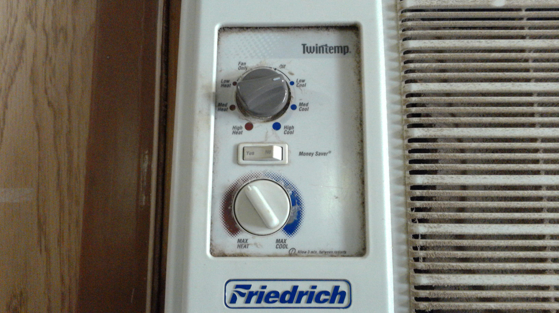
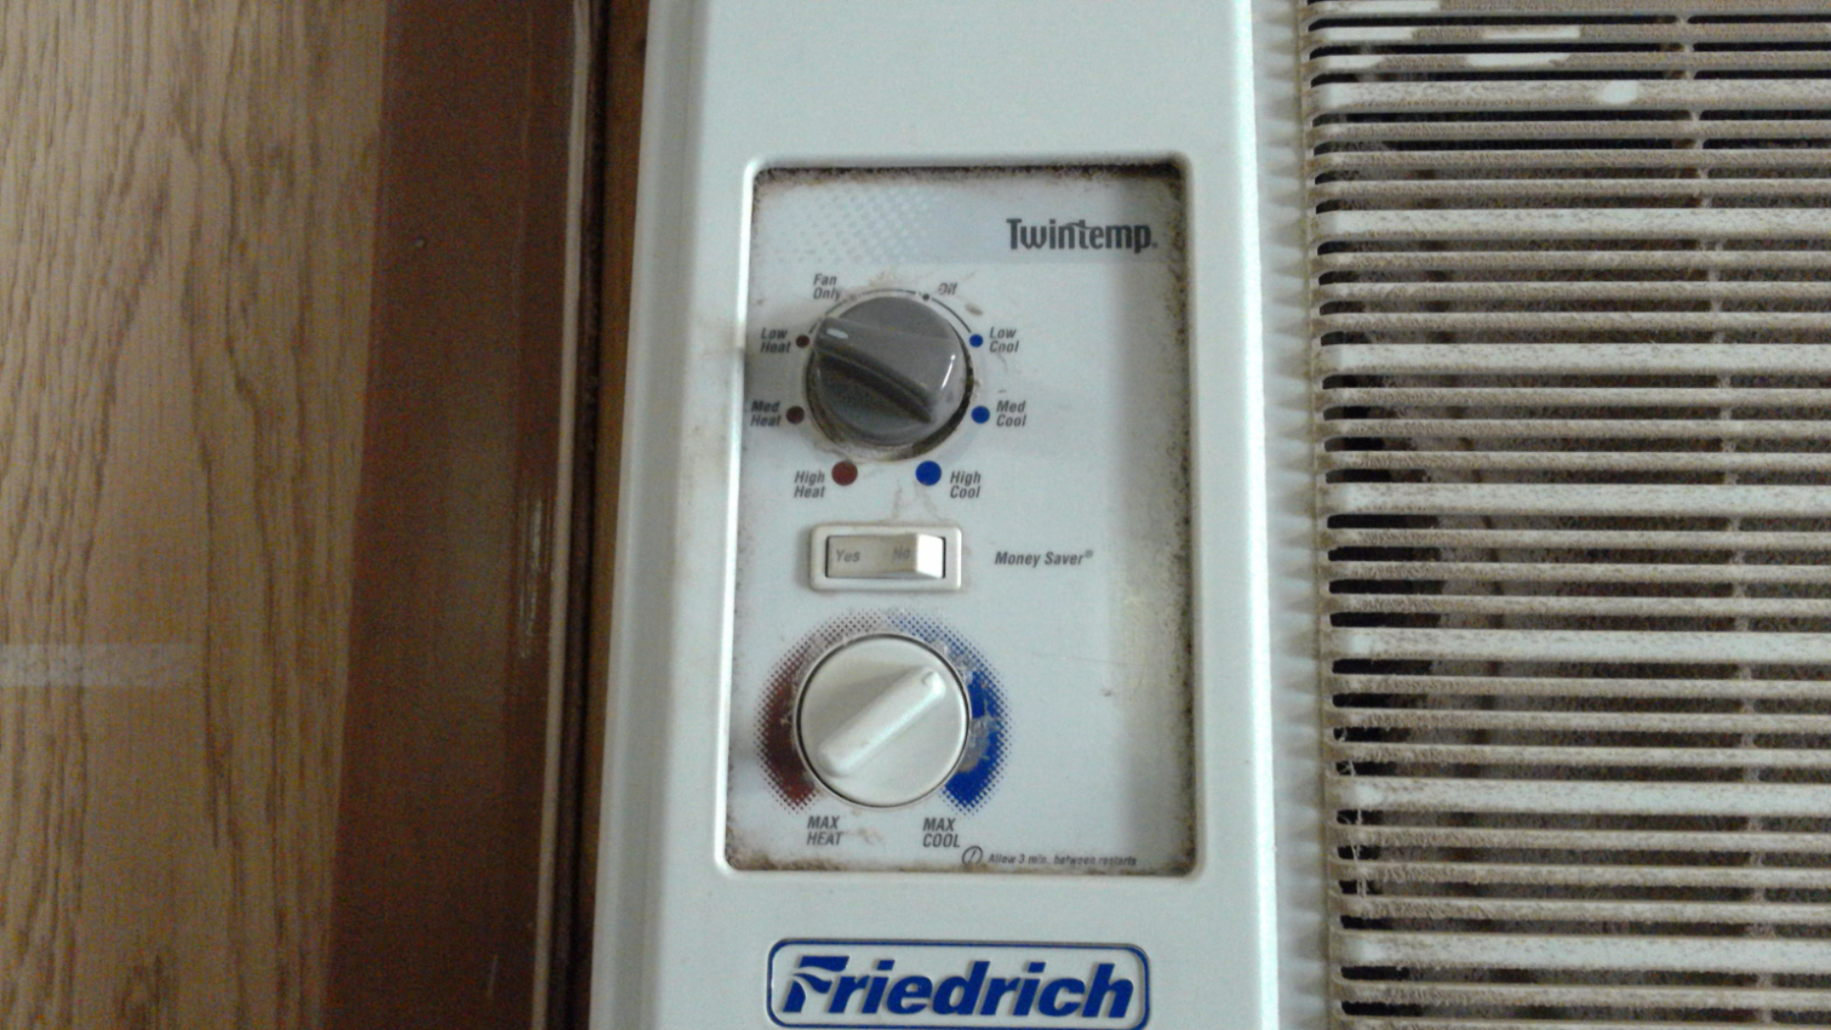
portables
Turn OFF Daily unless we have extreme temperatures (Above 90…Below 35)

Slide 10
Energy Conservation Inquiries & Troubleshooting
Mike Scott – Extension 8536 / michael.scott@abileneisd.org
Todd Whisenhunt – Extension 7201/ lawrence.whisenhunt@abileneisd.org
Follow us on twitter @AISDEnergy and visit us online www.abileneisd.org
Notes:
Communicate with your school liason if you are having comfort issues.

